Slide 1


Slide 2
Increase comfort
Save energy
Home security
New
houses or flats
Existing
houses or flats

Slide 3
Today’s market segmentation
Community
Versions
System
Providers

Slide 4
Community targets
technical skilled people
Community
Versions
Programming skills
for
customization
Difficult for people to use such platforms

Slide 5
Software chained
to hardware
System
Providers
Central hardware
architecture
Functions limited by R&D capacity
Notes:
Central hardware:
any failure shuts down the house our you loose control
like plants a house needs distributed controls which can take over functionality
Software chained to hardware:
Totally depending on hardware manufacturer: there is no long-term availability of hardware: how about compatibility for 15 years and more?
Although they are open to established communication prototcols, often only their own products work perfectly with their hardware. So you are forced to buy such products which bypasses any idea of a free market
Functions are limited by R&D capacity:
Because the software is not open only the system provider can add new functions. But the current IoT technology is growing way faster than a single company can keep up to this pace.

Slide 6
Central hardware architecture
Central Controller
Security
Entertainment
Doors and gates
User Interface
Heating
Blinds
Lights

Slide 7
Software chained to hardware
Your house still needs automation!
Home Automation
Software
Controller
Hardware
Discontinued components
Defects can not be repaired anymore
Company does not exist anymore
New Controller
Hardware

Slide 8
Functions limited by R&D capacity
Number resources
Home Automation
Company
Functionality of
Home Automation System

Slide 9
Depending on single companies

Slide 10
Create a free software market
for
Home Automation
based on an
Open Source Platform
Notes:
How?

Slide 12
Y
et
a
nother
h
ome
a
utomation

Slide 13



Open Source
Free of charge
Uses open platforms
Web-based UI

Slide 14

Customization with Add-ons
Set-up service
Free new market
Equipment

Slide 15
Unmatched innovation power
Community powered
More than 1000 developers are simplifying your live
Yaha store brings out the best for your home
High availability
Modules run decentralized on multiple systems
Easy service with central configuration storage
Multiple visualization access
Perfectly fitting your needs
Full fledged home automation solution
Ready made economic solutions
Open platform for hobbyists
Future proof
Open source platform
Hardware independent
20 years experience in industrial engineering

Slide 16
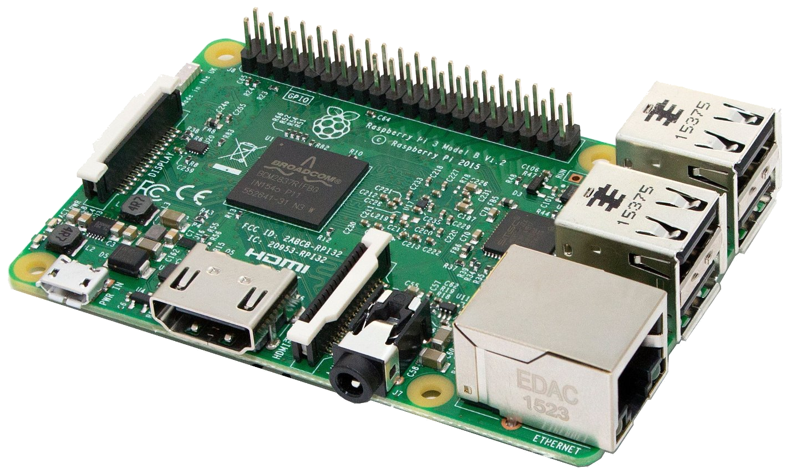


Sensors
ModbusTCP
Enocean
GPIO
ABE
…
Actuators
Web-based UI

Slide 17
Any web client
HTML, CGI
Apache HTTP server
Open platform
Sockets
runtime

Slide 18
Any web client
HTML, CGI
Apache HTTP server
Open platform
Sockets
runtime

Slide 19
Sockets
UI server
IO Drivers
Add-on Modules
Y2Y server
EnOcean
Process
Data
Image
Heating
HTML, CGI
Modbus
Blinds
Apache HTTP server
ABE boards
Weather
GPIO
Lights
Sockets
Y2Y client
…
runtime
Cyclic system

Slide 20
Module UI web containers
Heating
Blinds
Lights
…
HTML, CGI
Languages
Container
Languages
Container
Languages
Container
Languages
Container
Apache HTTP server
Sockets
View engine based in jQuery and D3
runtime
Yaha Juice - JavaScript Framework

Slide 21
Any web client
HTML, CGI
Apache HTTP server
Open platform
Sockets
runtime

